Slide 1
Prototyping

Slide 2


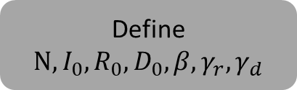
Define $N, I_{0}, R_{0},D_{0},β, γ_{r}, γ_{d}$
1
2
3
Numerical solution of the SIR model using a
Runge-Kutta method
(SIR.py)
Code extended to solve SIRD model numerically
(SIRD.py)
Simulated SIRD time series
Code to estimate parameters from surveillance data
(inverse.py)
Estimated parameters
5
4
Original and reconstructed SIRD series compared
(inverse.py)
Code to reconstruct the surveillance data from estimated params
(inverse.py)
Reconstructed SIRD time series

Slide 3
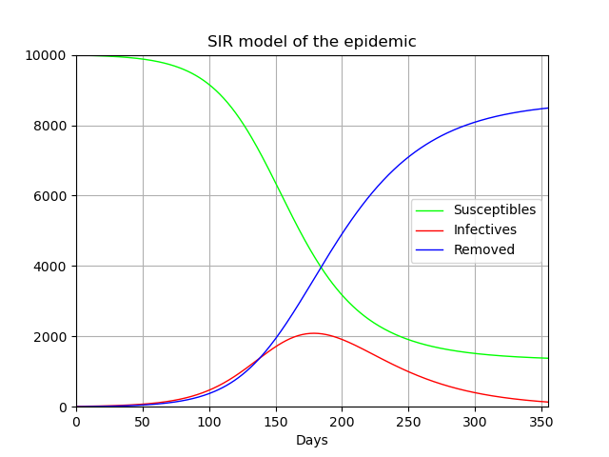
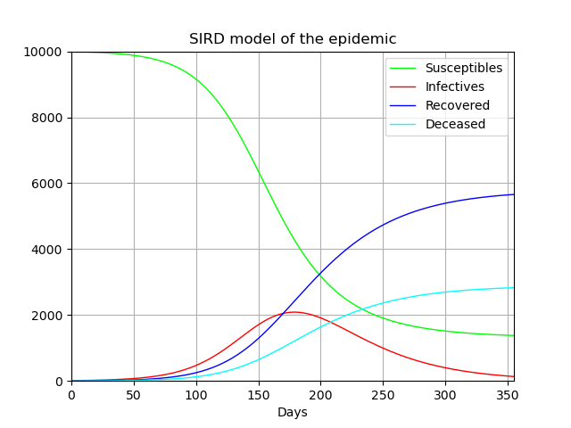
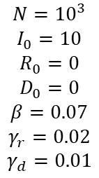
Define $N, I_{0}, R_{0},D_{0},β, γ_{r}, γ_{d}$
1
2
Numerical solution of the SIR model using a
Runge-Kutta method
(SIR.py)
Code extended to solve SIRD model numerically
(SIRD.py)
Simulated SIRD time series
$$N={10}^{3}$$
$$I_{0}=10$$
$$R_{0}=0$$
$$D_{0}=0$$
$$β=0.07$$
$$γ_{r}=0.02$$
$$γ_{d}=0.01$$

Slide 4

Define $N, I_{0}, R_{0},D_{0},β, γ_{r}, γ_{d}$
1
2
Numerical solution of the SIR model using a
Runge-Kutta method
(SIR.py)
Code extended to solve SIRD model numerically
(SIRD.py)
Simulated SIRD time series
$$S\left(t\right)$$
$$I\left(t\right)$$
$$R\left(t\right)$$
$$D\left(t\right)$$
$$N={10}^{3}$$
$$I_{0}=10$$
$$R_{0}=0$$
$$D_{0}=0$$
$$β=0.07$$
$$γ_{r}=0.02$$
$$γ_{d}=0.01$$

Slide 5

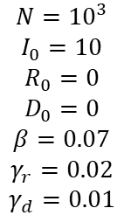

3
Simulated SIRD time series
Code to estimate parameters from surveillance data
(inverse.py)
$$N={10}^{3}$$
$$I_{0}=10$$
$$R_{0}=0$$
$$D_{0}=0$$
$$β=0.07$$
$$γ_{r}=0.02$$
$$γ_{d}=0.01$$
$$S\left(t\right)$$
$$I\left(t\right)$$
$$R\left(t\right)$$
$$D\left(t\right)$$
Estimated parameters
$$N$$
$$I_{0}$$
$$R_{0}$$
$$D_{0}$$
$$\hat{β}\left(t\right)$$
$${\hat{γ}}_{r}\left(t\right)$$
$${\hat{γ}}_{d}(t)$$
4
Code to reconstruct the surveillance data from estimated params
(inverse.py)
Reconstructed SIRD time series

Slide 6
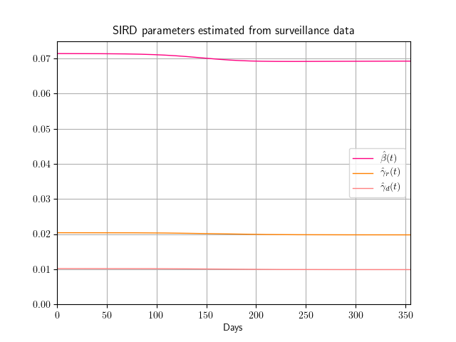
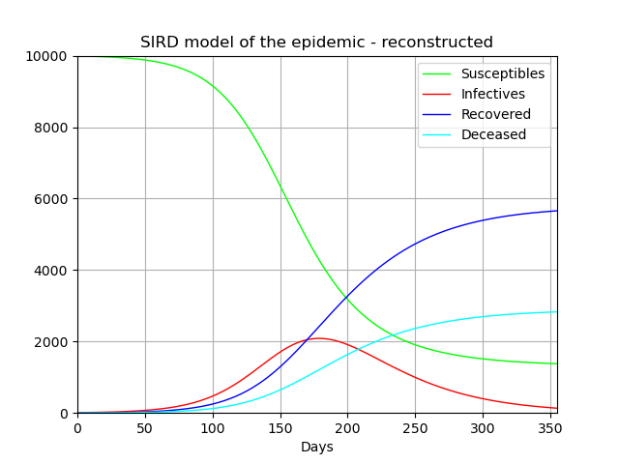

3
Simulated SIRD time series
Code to estimate parameters from surveillance data
(inverse.py)
$$N={10}^{3}$$
$$I_{0}=10$$
$$R_{0}=0$$
$$D_{0}=0$$
$$β=0.07$$
$$γ_{r}=0.02$$
$$γ_{d}=0.01$$
$$S\left(t\right)$$
$$I\left(t\right)$$
$$R\left(t\right)$$
$$D\left(t\right)$$
Estimated parameters
$$N$$
$$I_{0}$$
$$R_{0}$$
$$D_{0}$$
$$\hat{β}\left(t\right)$$
$${\hat{γ}}_{r}\left(t\right)$$
$${\hat{γ}}_{d}(t)$$
4
Code to reconstruct the surveillance data from estimated params
(inverse.py)
$$\hat{S}\left(t\right)$$
$$\hat{I}\left(t\right)$$
$$\hat{R}\left(t\right)$$
$$\hat{D}\left(t\right)$$
Reconstructed SIRD time series

Slide 7
3
Simulated SIRD time series
Code to estimate parameters from surveillance data
(inverse.py)
$$S\left(t\right)$$
$$I\left(t\right)$$
$$R\left(t\right)$$
$$D\left(t\right)$$
Estimated parameters
$$N$$
$$I_{0}$$
$$R_{0}$$
$$D_{0}$$
$$\hat{β}\left(t\right)$$
$${\hat{γ}}_{r}\left(t\right)$$
$${\hat{γ}}_{d}(t)$$
5
4
Original and reconstructed SIRD series compared
(inverse.py)
Code to reconstruct the surveillance data from estimated params
(inverse.py)
Mean Squared Error
(MSE)
$$\hat{S}\left(t\right)$$
$$\hat{I}\left(t\right)$$
$$\hat{R}\left(t\right)$$
$$\hat{D}\left(t\right)$$
Reconstructed SIRD time series

Slide 8
3
Simulated SIRD time series
Code to estimate parameters from surveillance data
(inverse.py)
$$S\left(t\right)$$
$$I\left(t\right)$$
$$R\left(t\right)$$
$$D\left(t\right)$$
Estimated parameters
$$N$$
$$I_{0}$$
$$R_{0}$$
$$D_{0}$$
$$\hat{β}\left(t\right)$$
$${\hat{γ}}_{r}\left(t\right)$$
$${\hat{γ}}_{d}(t)$$
5
4
Original and reconstructed SIRD series compared
(inverse.py)
Code to reconstruct the surveillance data from estimated params
(inverse.py)
Mean Squared Error
(MSE)
$$\hat{S}\left(t\right)$$
$$\hat{I}\left(t\right)$$
$$\hat{R}\left(t\right)$$
$$\hat{D}\left(t\right)$$
Reconstructed SIRD time series

Slide 9
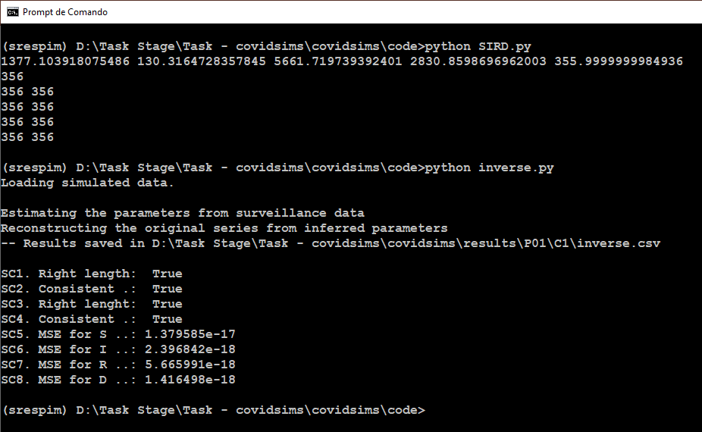

Slide 10
Testing with real data

Slide 11
Peddireddy or
IB-forward method
3
Surveillance data from Brasil.io
Preprocess time series from surveillance data
(preprocess.py)
Real SIRD time series
Code to estimate parameters from surveillance data
(inverse.py)
Estimated parameters
5
4
Original and reconstructed SIRD series compared
(inverse.py)
Code to reconstruct the surveillance data from estimated params
(inverse.py)
Reconstructed SIRD time series

Slide 12
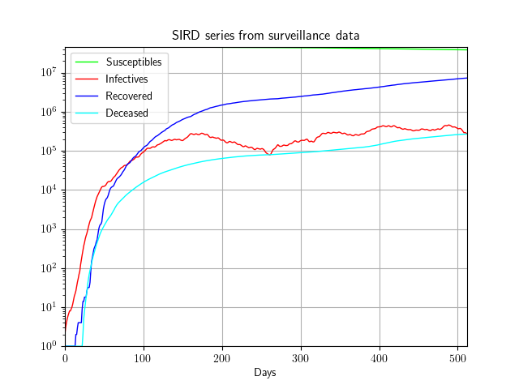
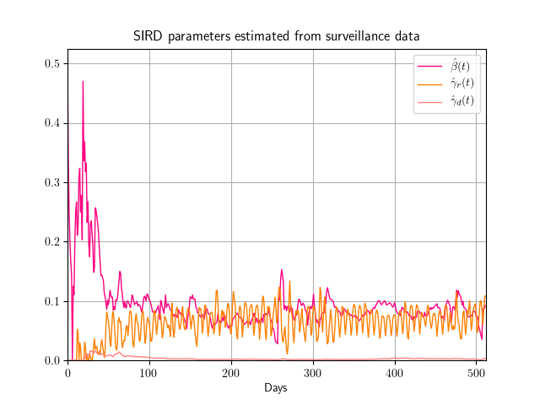
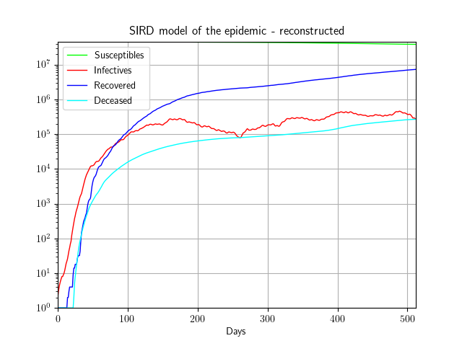
3
Real SIRD time series
Code to estimate parameters from surveillance data
(inverse.py)
$$S\left(t\right)$$
$$I\left(t\right)$$
$$R\left(t\right)$$
$$D\left(t\right)$$
Estimated parameters
$$N$$
$$I_{0}$$
$$R_{0}$$
$$D_{0}$$
$$\hat{β}\left(t\right)$$
$${\hat{γ}}_{r}\left(t\right)$$
$${\hat{γ}}_{d}(t)$$
4
Code to reconstruct the surveillance data from estimated params
(inverse.py)
$$\hat{S}\left(t\right)$$
$$\hat{I}\left(t\right)$$
$$\hat{R}\left(t\right)$$
$$\hat{D}\left(t\right)$$
Reconstructed SIRD time series

Slide 13
3
Real SIRD time series
Code to estimate parameters from surveillance data
(inverse.py)
$$S\left(t\right)$$
$$I\left(t\right)$$
$$R\left(t\right)$$
$$D\left(t\right)$$
Estimated parameters
$$N$$
$$I_{0}$$
$$R_{0}$$
$$D_{0}$$
$$\hat{β}\left(t\right)$$
$${\hat{γ}}_{r}\left(t\right)$$
$${\hat{γ}}_{d}(t)$$
5
4
Original and reconstructed SIRD series compared
(inverse.py)
Code to reconstruct the surveillance data from estimated params
(inverse.py)
Mean Squared Error
(MSE)
$$\hat{S}\left(t\right)$$
$$\hat{I}\left(t\right)$$
$$\hat{R}\left(t\right)$$
$$\hat{D}\left(t\right)$$
Reconstructed SIRD time series

Slide 14
3
Real SIRD time series
Code to estimate parameters from surveillance data
(inverse.py)
$$S\left(t\right)$$
$$I\left(t\right)$$
$$R\left(t\right)$$
$$D\left(t\right)$$
Estimated parameters
$$N$$
$$I_{0}$$
$$R_{0}$$
$$D_{0}$$
$$\hat{β}\left(t\right)$$
$${\hat{γ}}_{r}\left(t\right)$$
$${\hat{γ}}_{d}(t)$$
5
4
Original and reconstructed SIRD series compared
(inverse.py)
Code to reconstruct the surveillance data from estimated params
(inverse.py)
Mean Squared Error
(MSE)
$$\hat{S}\left(t\right)$$
$$\hat{I}\left(t\right)$$
$$\hat{R}\left(t\right)$$
$$\hat{D}\left(t\right)$$
Reconstructed SIRD time series

Slide 15
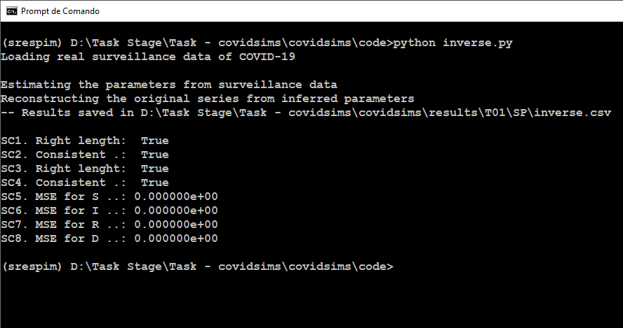

Slide 16
Predict future values of parameters

Slide 17



3
4
Future values
$$\hat{β}\left(t\right)$$
$${\hat{γ}}_{r}\left(t\right)$$
$${\hat{γ}}_{d}(t)$$
$$\hat{S}\left(t\right)$$
$$\hat{I}\left(t\right)$$
$$\hat{R}\left(t\right)$$
$$\hat{D}\left(t\right)$$
5
Estimated from current surveillance data
$$S\left(t\right)$$
$$I\left(t\right)$$
$$R\left(t\right)$$
$$D\left(t\right)$$

